Slide 1

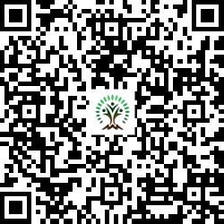


IONIQ Forest
Grid – B Zones 1 -10

Slide 2
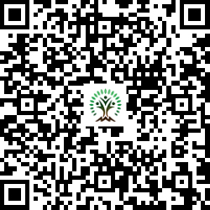
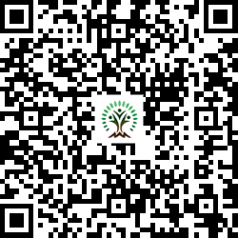
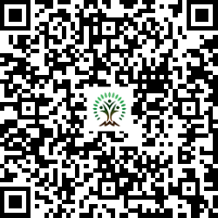
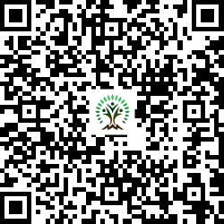
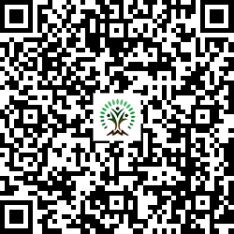
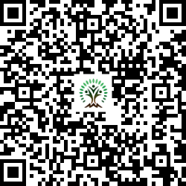
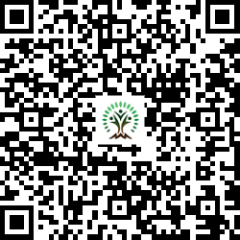
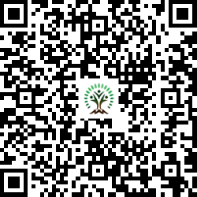
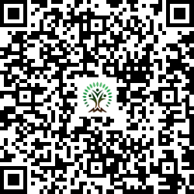
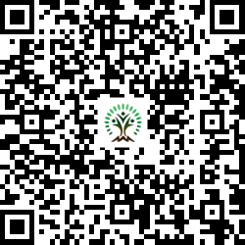
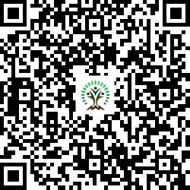
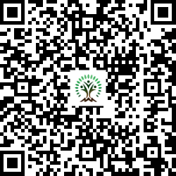
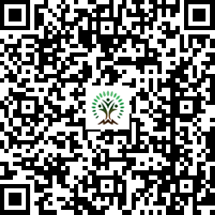
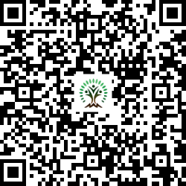
Sr. No. | Scientific Name | Common Name | QR Code
1 | Annona squamosa L | Custard apple
2 | Artocarpus heterophyllus | Jackfruit
3 | Azadirachta indica | Neem Tree
4 | Butea monosperma | Flame of the Forest
5 | Cassia fistula | Golden shower tree
6 | Dalbergia sissoo | Indian rosewood
7 | Holoptelea integrifolia | Jungle cork tree
Sr. No. | Scientific Name | Common Name | QR Code
8 | Lagerstroemia speciosa | Pride of India
9 | Melia dubia | Malabar Neem
10 | Mimusops elengi | Spanish cherry
11 | Morus nigra | mulberry
12 | Neolamarckia cadamba | Burrflower tree
13 | Pongamia pinnata | Indian Beech Tree
14 | Psidium guajava | Guava

Slide 3
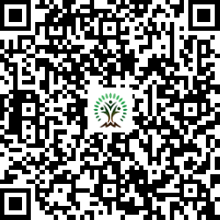
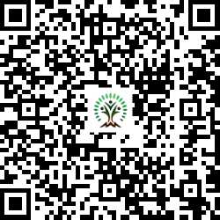
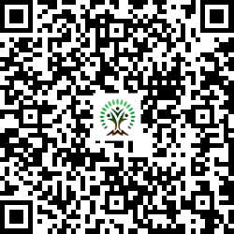
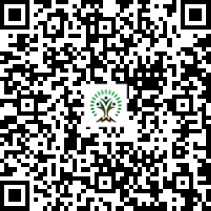
Sr. No. | Scientific Name | Common Name | QR Code
15 | Tamarindus indica L. | Tamarind
16 | Terminalia arjuna | White Murdah
17 | Thespesia populnea | Indian tulip tree
18 | Toona ciliata | Indian mahogany

